Slide 1
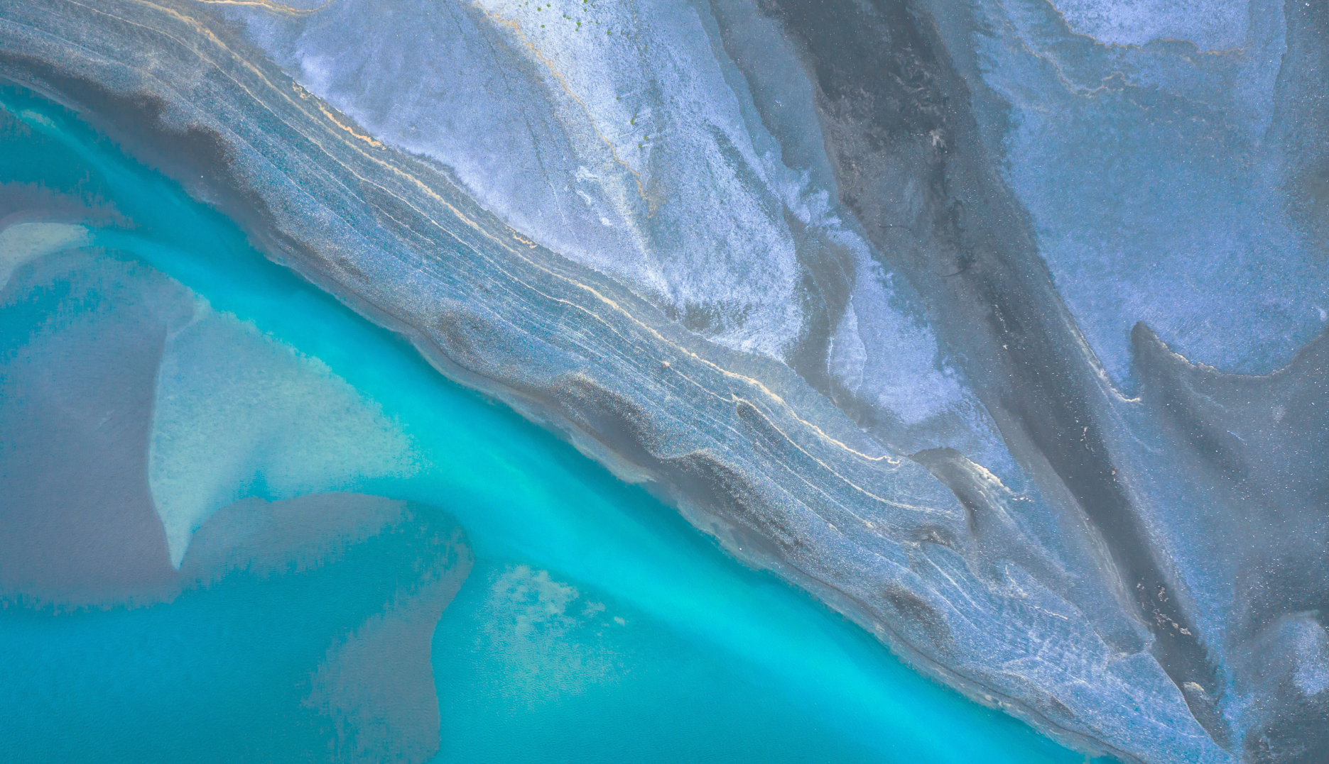

Previous Footprint Fund Grand Prix Winners

Slide 2


Slide 3


Slide 4
