Slide 1
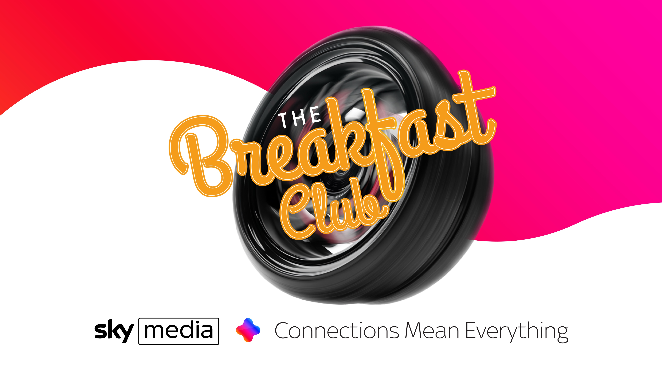

Slide 2
SPEAKERS
Charlotte George, Advertiser Partnerships Controller, Sky Media
Wayne Butler, Head of Media Effectiveness, Sky Media
Steve Wild, Head of Sales, Sky Media
Chris Green, CEO & Founder, Regit
Laura Ougden, Brand Awareness Manager, Lexus
,

Slide 3


Slide 5
Customers
Innovation
Culture
Partners
Notes:
Connections mean everything is underpinned by our unique connections to Customers, Culture, Partners and Innovation. Through these, we can connect better with you to deliver better outcomes for you as brands and for the agency folk, your clients

Slide 6
Connected to Customers
Notes:
At Sky, we’re connected to our customers through a range of products and services – TV remains the core business but connectivity is now critical – it’s the fuel that means people can access the content they love.
For you and your clients, connectivity matters because it enhances the quality of our customer data.

Slide 7
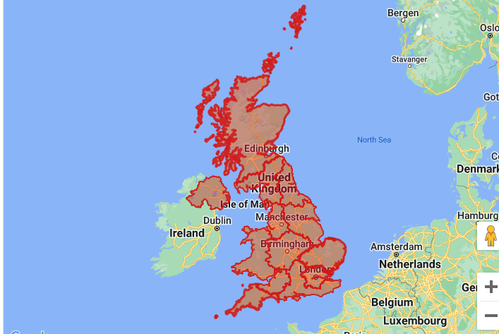
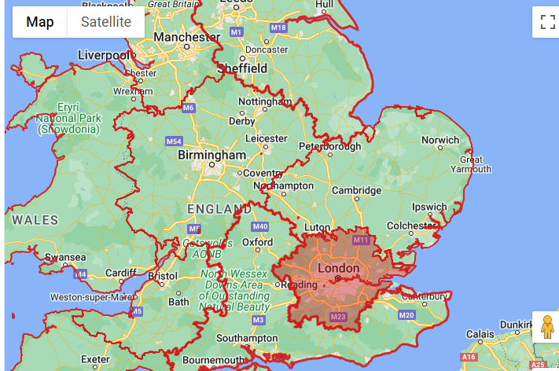
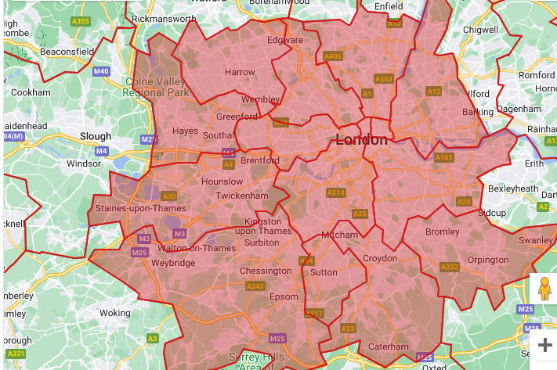
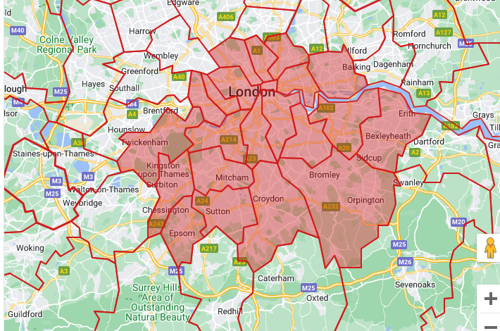
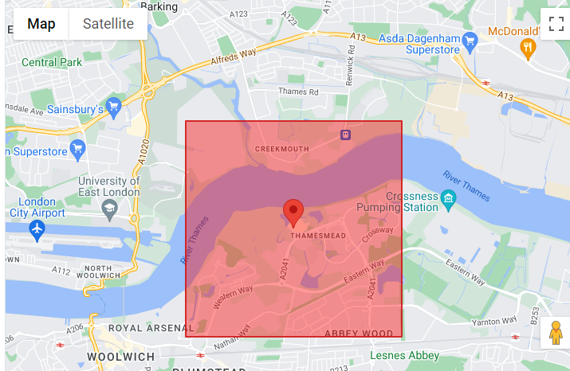
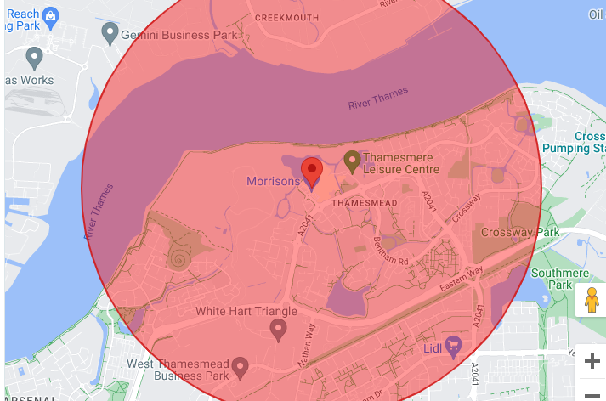
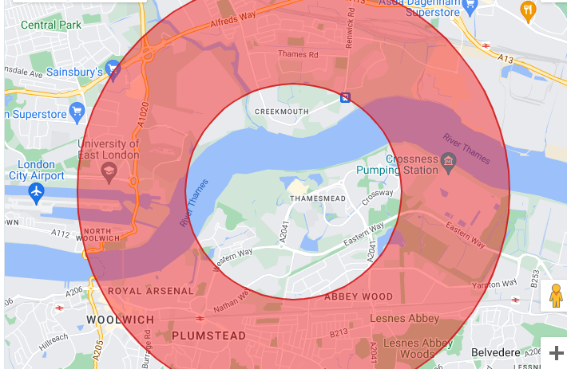
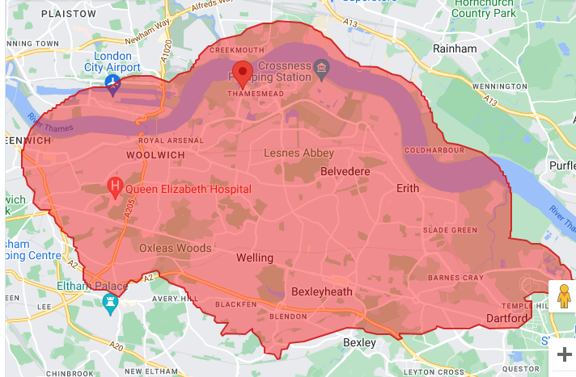
Qualified & Verified data enables hyper-precision and ‘test & learn’
13 TV Regions
31 Metropolitan Areas
121 Postcode Areas
317 Local Authorities
Geo-Box
Radius
Doughnut
Drive Time
Notes:
Sky rich data proposition, coupled with our unique targeting capabilities sets us apart when it comes to Connecting with your customers.
Our precision geo targeting capabilities allow brands to target broad TV regions right down to hyper targeted drive times.
Automotive brands benefit from being able to target in market audiences local to their nearest dealers using our Drive Time and Radius targeting capabilities.

Slide 8

Wealth of data opportunities exist for Automotive brands to reach highly targeted and refined, in-market audiences
4.5m+ vehicle owners verified by reg number
46m Vehicle registration government database and survey data
In-market audiences for today’s needs (Electric / Hybrid / Used / After Sales)
100+ Individual characteristics to build a detailed profile of each vehicle owner
Bespoke audience builds available to activate on live, on demand and digital campaigns
75 Audience builds available off-the-shelf for live, on demand and digital campaigns
Notes:
At Sky Media, you get access to the two leading providers of in market automative data in the UK, namely Experian Auto & Regit, provide access to highly sort after in-market audiences at scale.

Slide 9

Addressable for automotive
Powered by Experian, designed for Sky Media
46^{m}
100⁺
75⁺
Vehicle records
Genuine registrations from government database
Individual characteristics
Experian draw from their rich database to build a detailed profile of each vehicle owner
Audience builds
Designed for Sky Media and available off-the-shelf for live, on demand and digital campaigns

Slide 10
Reach in-market households by vehicle type via Experian
NEW OR USED
SIZE OF VEHICLE
Super mini, mini, medium, MPV, light commercial
VALUE
Economy, mid, premium, luxury, sports, utility

Slide 11

Finding in-market households for electric and hybrid vehicles through Experian
4
AdSmart reaches relevant audiences at a household level
3
Household address verified for each Sky subscriber
2
Experian profiles owners of electric/hybrid vehicles to find those in-market
1
Vehicle registration government database and survey data
Notes:
Let’s look at that in more detail at Elec / Hybrid as it’s such an important salient audience at the moment…
1) Vehicle registration government database and survey data
Purchase intent data is derived from market research where respondents are asked about their intention to buy a new vehicle. Vehicle registration data identifies current electric and hybrid owners
2) Experian profiles those in-market for electric/hybrid vehicles using segmentation
Experian uses their Mosaic segmentation to determine the audience profile of those who own an electric/hybrid vehicle, as well as those who have signalled their intention to purchase. Experian identify relevant demographics and characteristics to reach lookalike households.
3) Household address verified for each Sky subscriber
Other Addressable TV solutions in market often rely on email addresses, to ad-serve to specific devices. Viewers are requested to provide details at log-in stage and this data is then used for targeting purposes. Our viewers don’t need to provide any details before accessing our content. AdSmart targets at a household level, with every address verified for each of our subscribers.
4) AdSmart reaches relevant audiences at a household level
Targeting at a household level with AdSmart means that advertisers either capture in-market individuals directly or influence them by reaching their nearest and dearest. Remember, 44% of TV is watched together with others. And when it comes to big purchases and life decisions, these are made by, and for the household.

Slide 12

Precision Automotive Targeting
Powered by Regit
Database of 4.5m verified vehicle owners
In-market audiences (Electric / Hybrid / Used / After Sales)
Activate on live, on demand and digital campaigns

Slide 13
Deterministically reach ‘In-Market’ households for Electric Vehicles through Regit
4
Deterministically reach the most relevant Households for EV Opportunities through Addressable TV
3
Audience transferred to Sky through secure LiveRamp environment
2
EV Owners and Intenders aggregated to create ‘In-Market’ Audience
1
Households sign up to Regit, providing key vehicle metadata
Notes:
And we can do likewise for Regit with whom owners have signed up to provide vehicle data. EV / Hybrid owners and intenders can be aggregated to find I market audience that we can determinisitically reach but to explain more about the Regit opportunity, I’d like to hand over to my colleague Steve and Chris Green from Regit.

Slide 14
Let’s hear from Chris Green,
CEO & Founder, Regit

Slide 15
Sky Media offers holistic, closed loop effectiveness measurement
BRAND
Measuring ad cut through
Brand mention and familiarity KPIs
PERFORM
EVAL
EVALUATION
Campaign impact on brand
perceptions and purchase consideration
SELF SERVE
EVAL
WEB
Browsing specific product pages
ONLINE SALES
Registrations / baskets
PURCHASE
INTENT
ATTRIBUTION
Sales made through website
WEBSITE
BROWSING
SALES
Understanding the immediate impact of
TV exposure on response
BRAND IMAGE
ATTRIBUTION
Deep dive into TV Campaign performance through offline and online sales data provided by client
BRAND AWARENESS
AD RECALL
Notes:
Upper to mid funnel brand KPI measurement underpinned by Sky data
Mid funnel web attribution linking web visitors back to Sky viewing data
Lower funnel sales attribution linking TV exposure directly to client transactional data

Slide 16
Automotive brands are reaching a
receptive audience via Addressable from Sky
+21%
+18%
+40%
Spontaneous Ad Awareness
Prompted Ad Awareness
Creative Recall
% increase: Which brands have you seen any advertising for recently?
% increase: Which, if any, of these brands have you seen any advertising for recently?
% increase: Have you seen this advert before?
Sky AdSmart norms: Test v Control / All Automotive campaigns (n=29), May 2025

Slide 17
New entrants to the UK market have used Sky Addressable to successfully build brand awareness and familiarity.
Trended Results: Spontaneous & Prompted Brand Awareness 2023 v 2024
Prompted Brand Awareness
Trended
Prompted Brand Familiarity
Trended
Households Exposed to BYD Addressable campaigns
Households Exposed to BYD Addressable campaigns
Notes:
Impressive x3 growth in awareness in just over a year
Question – how to grow unaided brand mention (as well as other unaided measures)?
Increasing top of mind brand awareness is harder for less established brands – takes longer time and higher frequency
Exposure frequency shows a curve for aided measures – prompted awareness or consideration begins to flatten after 10 exposures on average
But the relationship between frequency and unaided measures is more linear – there is no observed curve, indicating that higher frequency, i.e more exposures continues to build top of mind measures.
Psychology –
The Power of Repeated Exposure (Zajonc 1968) - the more we see something, the more we develop a preference for it—even if we don’t consciously remember seeing it.
The Availability Heuristic (Tversky & Kahneman) states that our brains assume something is important and credible if we encounter it frequently.
To win mindshare, BYD should aim for continuous, emotionally engaging exposure

Slide 18
Online Car Marketplace Results Showcase
Plan
Measure
Optimise
Use Regit data to target in-market audiences for a new / used car
See the instant impact of the campaign through Web Attribution
Use learnings to optimise, re-plan and deliver even better outcomes
+66%
2X
Identify Sky households in-market for a new/used car through Regit
Campaign Uplift
Regit campaign twice as effective as other targeting
+17k
Over 600,000 homes available to target on Addressable TV
+48%
Incremental Web Visits
Impressions delivered on-demand were almost 50% more effective than Live
Over 3.5m Impressions delivered to in-market audience
+37
Incremental Car Sales
Notes:
Cinch’s OCA test drives +20k additional web visits over April-June 2024. The online car dealership ran two OCA campaigns in May to find those in-market to purchase a new vehicle. In total, the campaign drove +20k additional visits to the cinch website, including +43 orders. Both campaigns outperformed benchmarks for the automotive industry. The Regit audience targeted was more effective at driving web visits, with +0.51% of impressions translating into an incremental visit vs. +0.26% for Captify. Regit impression delivery was also closer to the profile of cinch web visitors which may have contributed to the better performance. VOD worked extremely well, driving most of the incremental web visits for both campaigns. The brand also ran Linear, which was effective at driving incremental visits at scale, with +53k incremental visits to the cinch website, reflecting a 17% uplift compared to those unexposed.

Slide 19
Connected to Culture
Notes:
We are also connected to a world of captivating content – creating moments that shape culture, bring together communities of fans and engage audiences around the content they love.

Slide 20
Notes:
Volvo chose to partner with Sky Atlantic when Volvo was seen as ‘safe’, not just rationally and functionally, but emotionally and culturally too. Atlantic was and still is, the antithesis of safe. Famous for its edgy, modern, distinctive, quality content, Atlantic has been the perfect vehicle to deliver Volvo’s objectives and transform the company from unfashionable to stylish.
During the Human Made Stories era, the partnership then evolved to attract key segments through the values they shared with Volvo. An objective to position Volvo as the “Defiant Pioneer brand for Defiant Pioneers”. By this point, Volvo’s brand metrics with Atlantic's audience were shifting upwards at pace.
In 2019, with both Sky and Volvo leading the way in environmental commitments, the partnership shifted gears to focus on Volvo’s sustainability promises and EV range; exciting consumers with a vision for electrification through five-minute films called ‘What does the future look like?
Entering its 10th year Volvo reclaimed its safety credentials in a modern way. Through our branded content “Safety in Action” we used the Sky Atlantic partnership to bring to life Volvo’s brand belief that “only when we live safe, can we live freely”
The most latest chapter of the Volvo & Sky Atlantic journey has seen them use our innovative smart technology to target sponsorship idents by audience, ensuring their message is delivered in the most relevant way possible.
Volvo’s journey with Sky Atlantic demonstrates how innovation and collaboration can redefine traditional sponsorship into a dynamic, audience-first experience. By launching the UK’s first "smart sponsorship," Volvo has elevated its brand equity while setting a new benchmark for integrated advertising.

Slide 21
The
undisputed
Home
Sport
of
Notes:
Sport, more than any other content, is at the heart of UK culture and Sky media is the ‘undisputed home of sport’. With the fragmentation of TV viewing, shared live viewing moments are rarer but across Sky Sports and TNT we deliver collective experiences week in week out through our live sports coverage alongside a breadth of sporting content across multiple platforms. That means we can offer you unparallelled access to sports fans 24x7, 365 days a year and help your brands leverage the unique relationship people have with sport.

Slide 22
Three tiers of Sky Sports channel licensing and integration
TIER 1
Sponsorship
TIER 2
‘Official Partner’ status
TIER 3
Presenting Partner

Slide 23
Introducing Laura Ougden,
Brand Awareness Manager, Lexus

Slide 25
Positive shifts in lexus brand objectives
Salience
Brand Who Reflects I Am
%
%
Source: GFK Brand Scan 2022 to 2024

Slide 26
TENNIS SPONSORSHIP IS BUILDING BRAND SALIENCE
Salience of Car Brands as a Tennis Sponsor
US Open
Davis Cup
BJK Cup
Australian Open
Surbiton, Eastbourne, Nottingham
Queens
Wimbledon
US Open
Launch of Sky Tennis
Brand A
Brand B
Brand C
Brand D
Source: YouGov Bespoke Tennis Tracking Study 2024
N = 1000, people interested in tennis

Slide 27
Lexus SKY idents performed strongly with Sky tennis viewers
Source: System 1 Lexus Sky Tennis Idents Nov 2024

Slide 28
Connected to Partners

Slide 29











The Ultimate Aggregator for Premium Content partners
Partners
+
Notes:
Connections to our partners are also important. Across TV and Digital we are the ultimate aggregator for premium content partners’ – bringing together over 130 TV channels and over 500 digital partners into a rich and diverse portfolio.

Slide 30
Partners supercharge our digital scale
+12%
#1
Growth in audience size (+4m)
Sports & News publisher on YouTube in the UK
400+
+10%
Publisher Player Partner Sites
Growth in video views Vs 2021
+13
+7ppts
Additional partner YouTube channels added in 2024
Exclusive digital reach grown by +7 percentage points
Source: Kantar Sky Media Landscape Study | YouTube Analytics | Tubular Audience Ratings

Slide 31
Connected to Innovation

Slide 32
EX90
EX30
Innovation
EX40
XC90
Notes:
And lastly Innovation, Connecting brands to emerging technologies and improving consumer experience helps brands reach new audiences in smarter ways.
To increase our scale we recently launched Sky’s first FAST service bringing over 70 new channels to our platforms and a suite of 6 brand new Sky Channels, available free to air on connected TV platforms
We’re simplifying our proposition by bringing targeting parity to our addressable products so you can now reach the same audience across AdSmart, VOD and Digital through ONE campaign
We’re enhancing our planning tools with genAI to help define audiences more easily and we’re making more inventory accessible programmatically through the trade desk
To help your campaigns stand out, after a series of successful tests, we’re enabling voice activated search from your ads into bespoke branded areas on our platforms where audiences can engage more with your brands

Slide 33
Thank You & Goodbye
Notes:
The thing that has always set Sky apart is that we’re both a content provider and a technology business. The perfect combination of art and science.
But as consumption and technology continues to evolve it creates both challenges and opportunities for everyone.
We know that although consumption of content has never been higher, consumers and advertisers are increasingly frustrated by the fragmented nature of the offerings. The power of Sky is that the whole is greater than the sum of its parts – bringing together our content, platforms and products to deliver better experiences for audiences and advertisers.

