Slide 1


Why TV?
Notes:
Endless tedious debate about what is TV and what isn’t TV
Just want to move beyond this and take advantage of the fantastic opportunities offered by TV

Slide 2
Linear TV: unmatched as the total Profit ROI volume driver
Source: Profit Ability 2, April 2024 – Short term benchmarks: Ebiquity, EssenceMediacom, Gain Theory, Mindshare, Wavemaker UK. Long Term Multipliers: EssenceMediacom, Gain Theory, Mindshare, Wavemaker UK. Immediate contribution = same week as advertising, Carryover = within 13 weeks, Sustained = within 2 years
Notes:
Adding in the sustained effect enables you to see the total profit delivery position.
Considering all three speeds of payback Linear TV is unmatched as the full profit volume driver – delivering c. 47% of total volume.

Slide 3
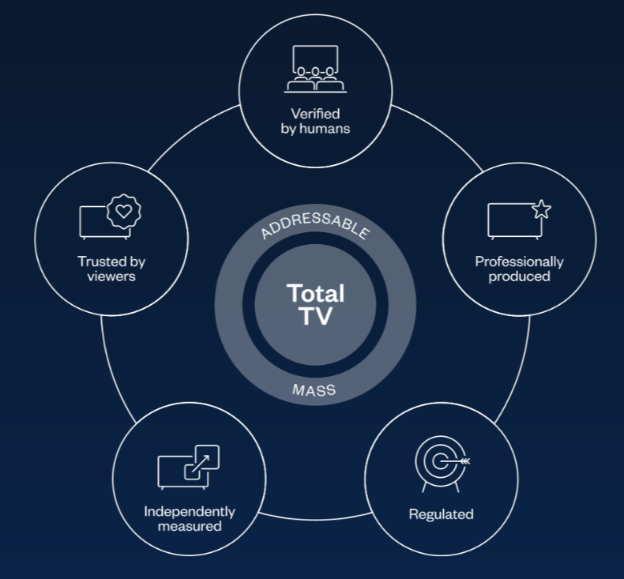
What is Total TV?
Notes:
There has been some debate about what is and what isn’t TV but really it’s pretty straightforward. Total TV should be defined not by a panel but by the people who matter: advertisers and viewers.
To advertisers, TV means professionally produced, regulated, independently measured and verified by humans. That means that everything that appears on the screen – both your advertising and the content it appears within – has been consciously approved by people so you can have confidence in the company you keep.
Viewers don’t really know or care about those things. They might know TV is regulated because they’re aware that there’s someone they can complain to or they might know that it’s measured since they see viewing figures after a big event but all those things simply translate into trust for viewers. TV and TV advertising is substantially more trusted than any other channel.
And rather than all the acronyms, Total TV is simply one extraordinary environment – linear, linear addressable, subscription platforms, broadcast video etc – that is available in two modes. Mass or 1 : many and addressable or 1:1.

Slide 4
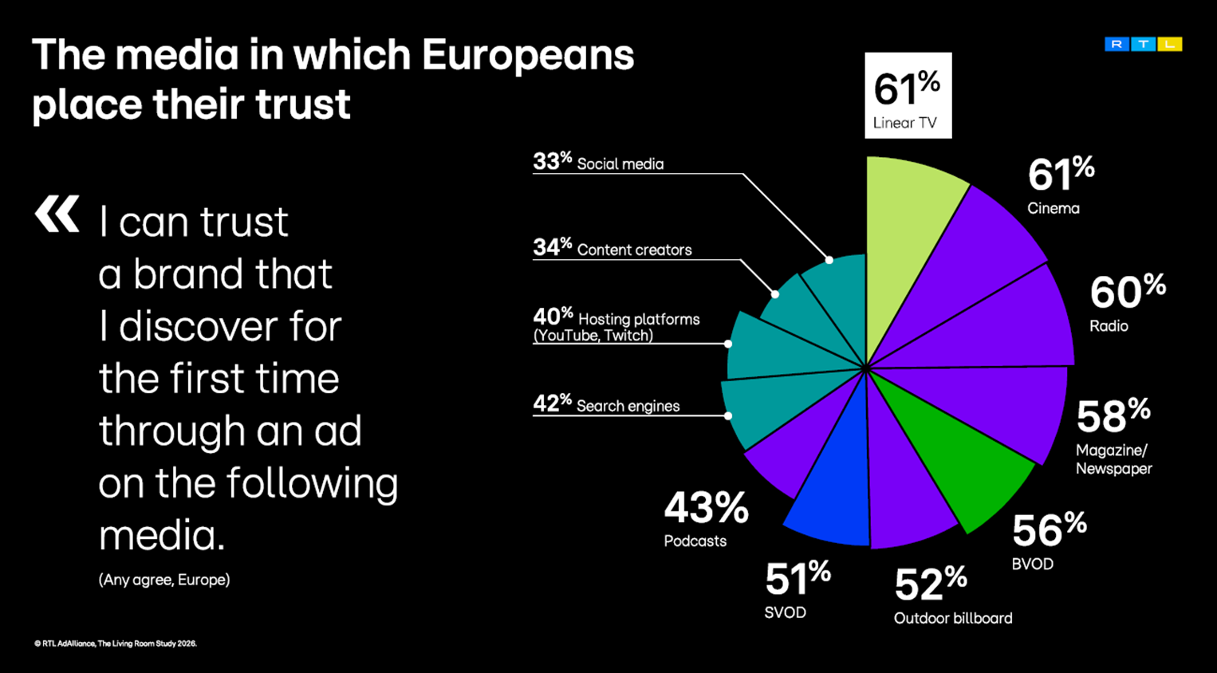

Slide 5
The viewing landscape

Slide 6
Total TV accounted for 70% of total video viewing in 2025
4 hrs 54 mins
Source: 2025, Barb / IPA TouchPoints 2025 / Pornhub / UK Cinema Association / Ipsos Iris
Total TV = Broadcaster TV, SVODs & AVODs

Slide 7
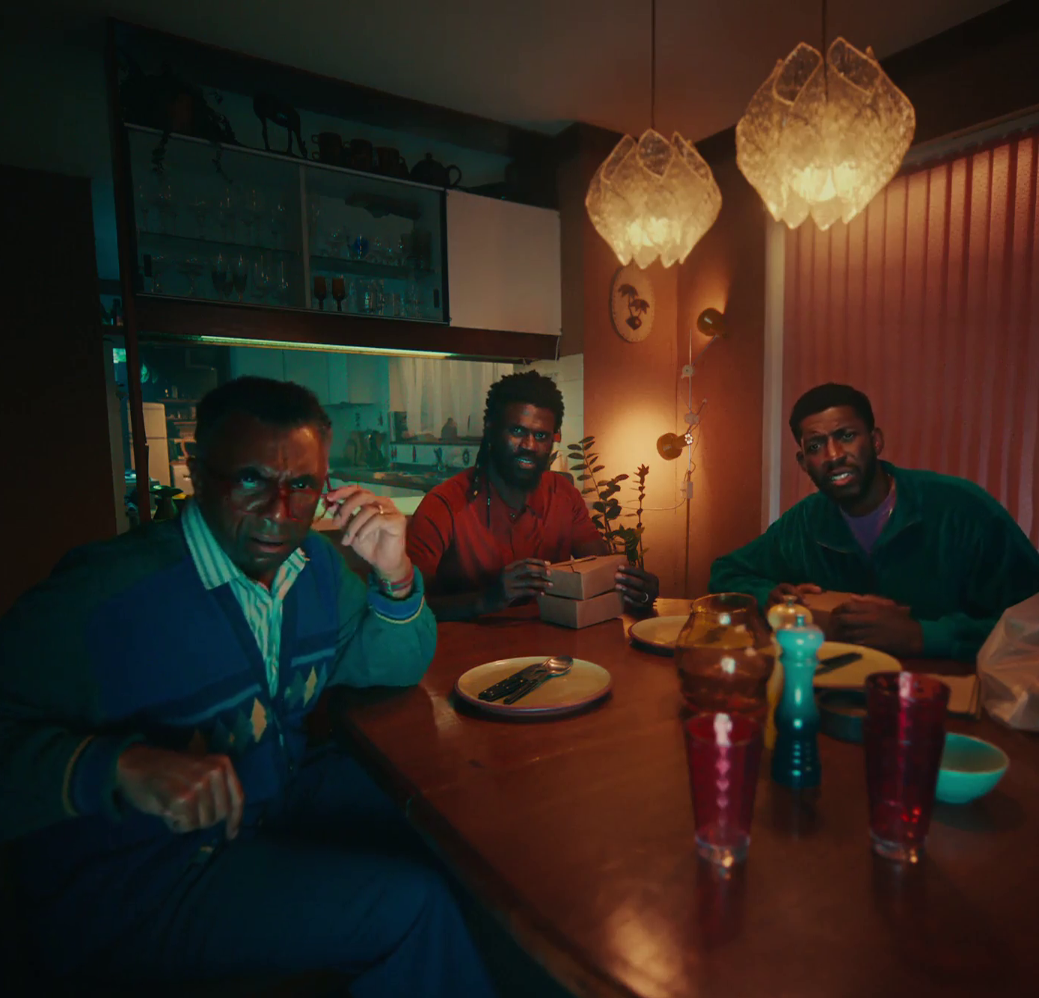
TV sets are the heart of entertainment
Smartphones (9%)
Tablets (3%)
PCs (4%)
TV set (84%)
U – U Talking To Me?
Source: Barb, In home viewing only. 2025. Adults 16+. Online Multiple Screens Network, Total Identified Viewing

Slide 8
The growth of VOD continues
To note: SVOD and YouTube viewing includes ad free tiers
-10%
+8%
+4%
+11%
-3%
+32%
Source: Barb, In home viewing only. All devices, Adults 16+, Total commercial linear TV and BVOD.
% difference based on 25 vs. 24

Slide 9
Little change across the other video areas
To note: SVOD and YouTube viewing includes ad free tiers
-10%
+8%
+4%
+11%
-3%
+32%
Source: Barb, In home viewing only. All devices, Adults 16+, Total commercial linear TV and BVOD.
% difference based on 25 vs. 24

Slide 10
Commercial broadcasters are unrivalled for scale
Adults – All devices
Bubble area represents total volume of daily viewing
AVERAGE DAILY REACH (000s)
Other
SVOD
Other AVOD
Twitch
AVE TIME VIEWED PER VIEWER PER DAY
Source: Barb / Adults, all devices – 2025
Notes:
.

Slide 11
Commercial broadcasters are unrivalled for scale
Adults – All devices
Bubble area represents total volume of daily viewing
AVERAGE DAILY REACH (000s)
Other
SVOD
Other AVOD
Twitch
AVE TIME VIEWED PER VIEWER PER DAY
Source: Barb / Adults, all devices – 2025
Notes:
.

Slide 12

Advertising Time
Xbox – Luke Littler

Slide 13
Total TV accounts for 85% of all AV advertising time
12%
Individuals
Ad time per day: 16:38
85%
Source: 2025, Barb / Broadcaster stream data / UK Cinema Association / Ipsos Iris
**YouTube ad time modelled at 3.33% of content time (Enders Analysis, 23rd October 2024) and excludes those estimated to be on the YouTube Premium tier. *TikTok ad time modelled at 3.4% of content time using agency and broadcaster estimates. **Other online modelled at 3.33% of content time.

Slide 14
16-34s spend more time with TV advertising than YouTube and TikTok combined
14%
48%
16-34s
Ad time per day: 8:58
33%
Source: 2025, Barb / Broadcaster stream data / UK Cinema Association / Ipsos Iris
**YouTube ad time modelled at 3.33% of content time (Enders Analysis, 23rd October 2024) and excludes those estimated to be on the YouTube Premium tier. *TikTok ad time modelled at 3.4% of content time using agency and broadcaster estimates. **Other online modelled at 3.33% of content time.

